Slide 1
ECS4003: Advanced Computer Engineering
Assignment 1: Thinking Slowly
Student Number: 40372849

Slide 2

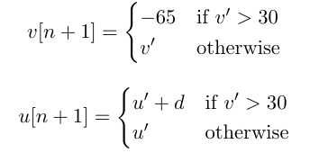
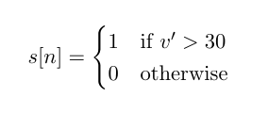
Part (a): Initial Untimed Implementation of the Formulae

Slide 3
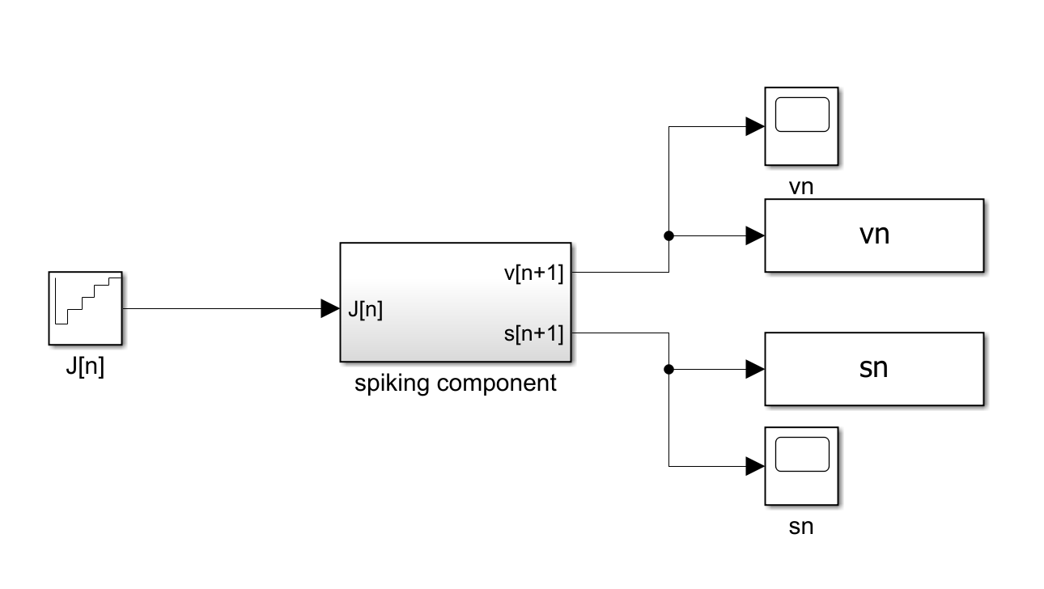

Slide 4
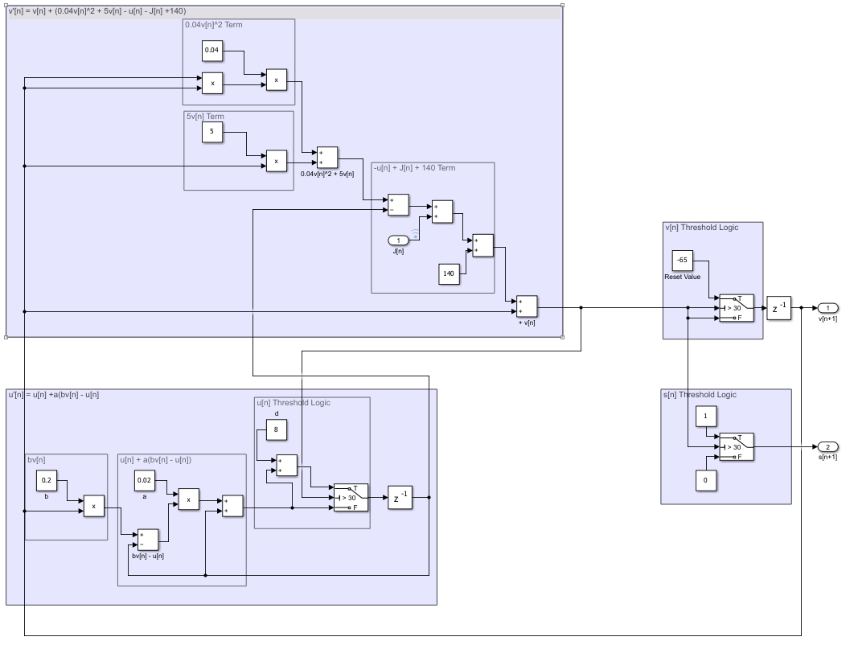

Slide 5
Part (b): Calculating Initiation Interval from Actor Latencies
Last 4 Digits of student number: 2849
Actor | Resulting Latency
Add | 2 % 4 = 2
Subtract | 8 % 4 + 2 = 2
Product | 4 % 4 + 2 = 2
Switch | 9 % 4 = 1

Slide 6
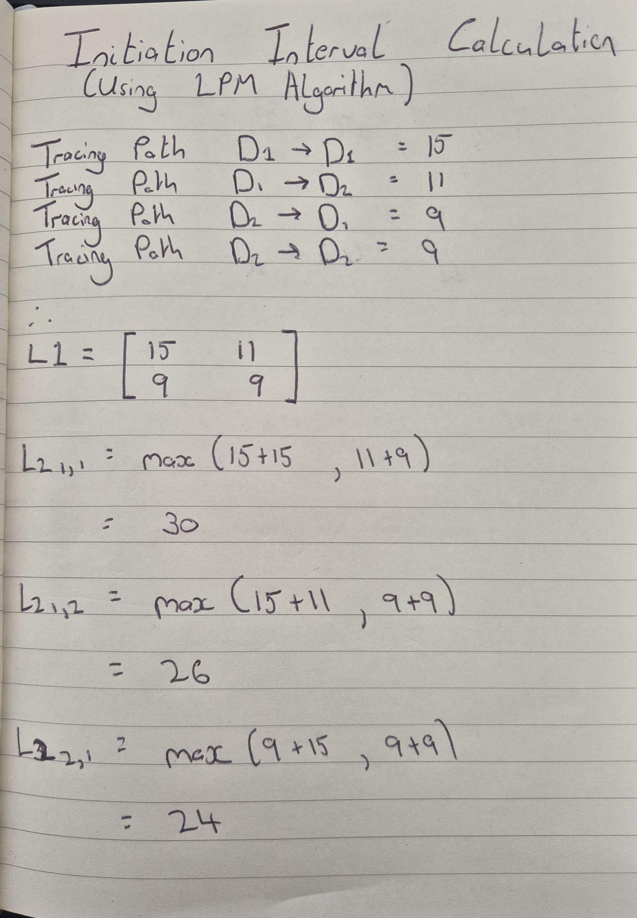
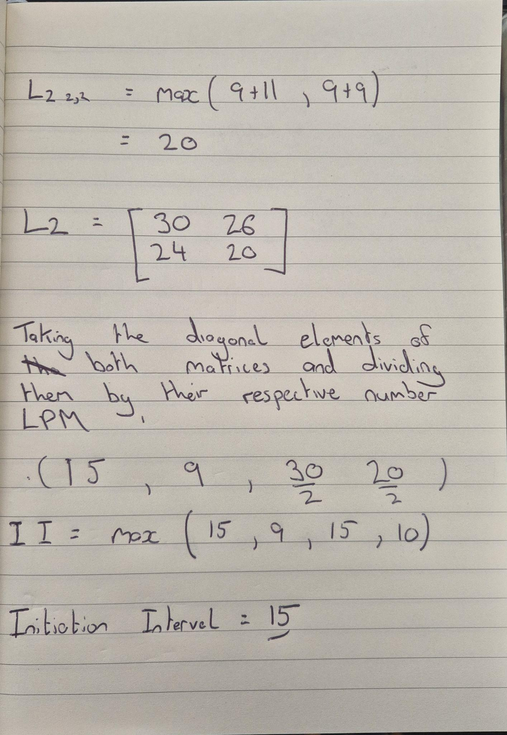
Part (b): Calculating Initiation Interval from Actor Latencies

Slide 7
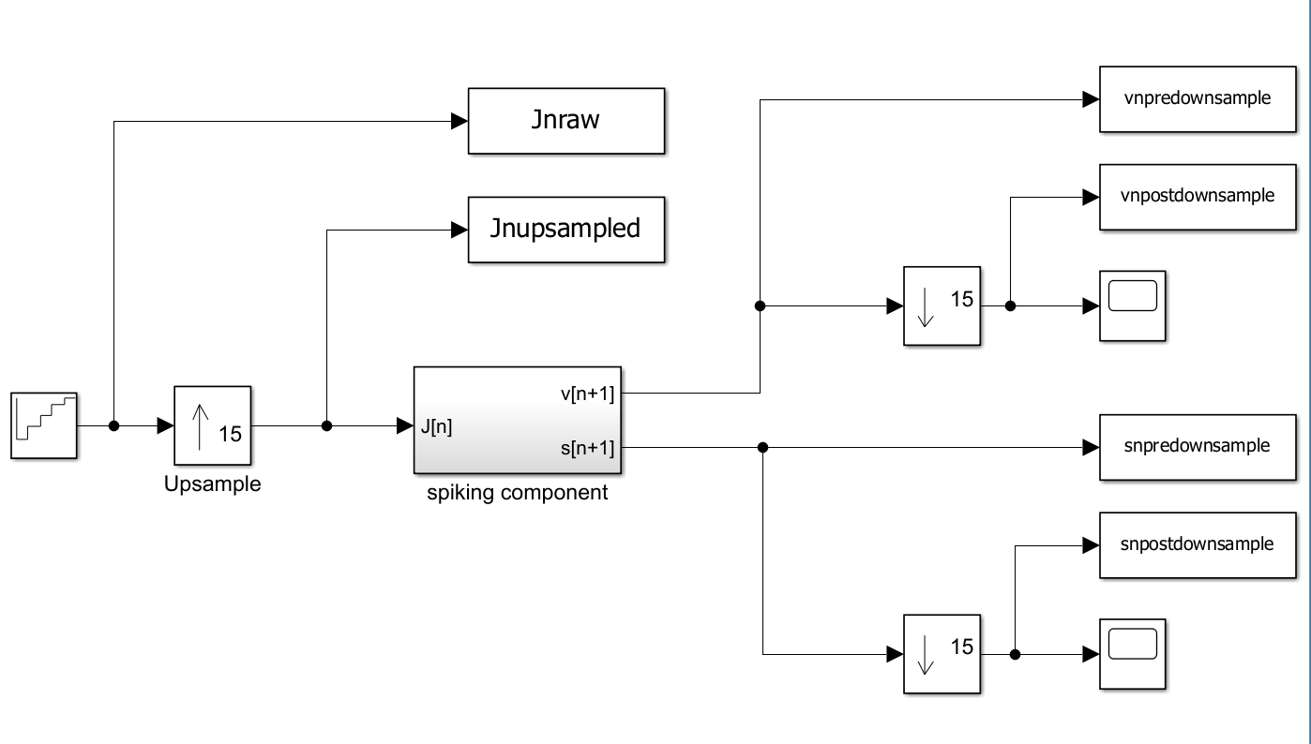
Part (c): Timed Implementation with Actor Latency

Slide 8
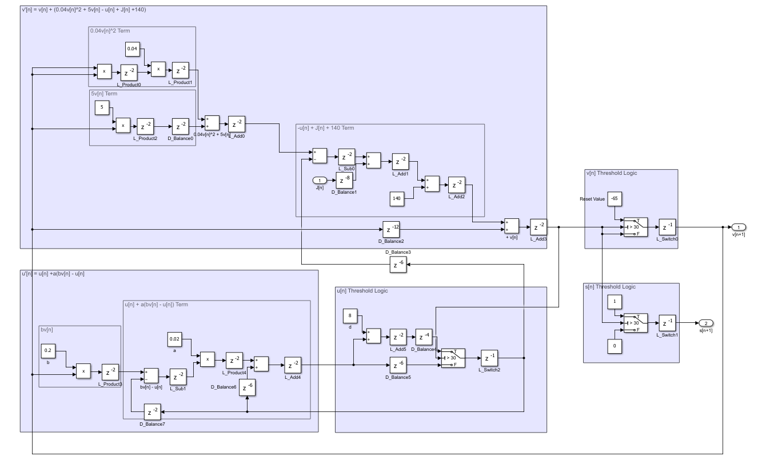

Slide 9
Part (d): Latency and Throughput
The latency of this streaming system is 15u.t
The throughput of this streaming system is given as:
1/(Initiation Interval) or 1/15 samples / u.t

Slide 10
Part (e,f): Latency and Cumulative Latency Optimisation
v[n] + v[n] ( 0.04v[n] + 5) - u[n] + J[n] + 140

